Slide 1
West Yorkshire County AGM
Tuesday, 21st JUNE 2022
Notes:
Welcome to this years County AGM. Thank you for your attendance.
Having taken on the role of interim Chair back in September, I am sorry I cannot be with you tonight, but sadly I am attending a funeral of one of my club members down in Somerset. A big thank you to Julie for stepping in to chair this meeting
Tonight is about giving you an overview of what has been happening this last season and to also begin to look forward to 2019/20.
This is your opportunity as members to influence how the County operates and moves forward to support you and your clubs. Netball in West Yorkshire is about you and we need to know what you as members want.
Both the Senior and Junior League AGMs will follow this meeting.

Slide 2
County AGM - Agenda
Welcome & Apologies for Absence
Minutes of AGM – 22nd June 2021 (ZOOM)
Matters arising
Minutes to be agreed and accepted
ANNUAL REPORT:
Officers reports
Competition
Schools
Officiating
Coaching
Performance
To receive County Accounts - Year ending 31st August 2021
To advise & approve the Membership Fees 2022/23
Amendments to the Constitution
Election of Officers
AOB

Slide 3
Meeting Protocols
All AGM documentation was placed on the web-site and everyone advised to read in advance of the meeting.
Please ensure that you have registered your name & who you are representing to help with our records of attendance.
Managed voting will take place for any item that needs member approval. Reminder that for the County AGM only 1 representative of each club or organisation is allowed to vote.
Any questions that arise will be answered at relevant times throughout the presentation, in AOB or included in the post meeting FAQs
Notes:
3

Slide 4
COMPETITION IN WEST YORKSHIRE
Last Year we reported on the amazing response we had in West Yorkshire to the RISE Again campaign to get netball competition back on court following Covid.
This year we can definitely report that netball is back, with more teams and players taking part than ever before.
Our member leagues are:
COUNTY SENIOR LEAGUE (Saturdays)
COUNTY JUNIOR LEAGUE (Sundays)
HUDDERSFIELD LEAGUE (Mid-week)
A BIG THANK YOU
To all our amazing volunteers who
make it possible
for teams to be able to play
‘
Notes:
4

Slide 5
RECOGNISING OUR WINNERS
SENIOR LEAGUE & JUNIOR LEAGUE AGMs will follow this meeting
Teams qualify for Yorkshire Regional and National Competitions
SENIORS:
Yorkshire Division 1 – Winners: Leeds Athletic Runners-Up: High Tech
Yorkshire Division 2 – Winners: Yorkshire Brodleians
JUNIORS:
Yorkshire U16’s – Winners: Leeds Athletic National Finals: 11th Place
Yorkshire U14’s – Winners: Leeds Athletic National Finals: 14th Place
U15 National Cup Championships (North): Leeds Athletic: 10th Place
Huddersfield Giants: 12th Place
U17 National Cup Championships (North): Leeds Athletic: 8th Place
Notes:
5

Slide 6
RECOGNISING OUR WINNERS
HUDDERSFIELD LEAGUE – Mid week competition running at various venues across Huddersfield, organised by clubs
Winter League 2021
Div 1: Hi Tech A / Fountain A
Div 2: Portland C / Holmfirth B
Div 3: Hepworth A / Fountain C
Summer League 2022 (31 teams)
Div 1: Hi Tech A / Fountain A
Div 2: Marsden A / Kelly’s Heroes 1
Div 3: Portland C / Mirfield
Div 4: Shelley B / Holmfirth D
Notes:
6

Slide 7
RECOGNISING OUR WINNERS
ENGLAND NETBALL – NATIONAL PREMIER LEAGUE
Congratulations
to
Leeds Athletic Netball Club
On their promotion to Division 1 of the National Premier League
This makes them one of the Top 10 teams in the country
Notes:
7

Slide 8
Schools
BACK for 2021/22
following a 2 year break
National Results
U19’s Woodhouse Grove 5th Place
Greenhead College 15th Place
U16’s The Grammar School at Leeds 9th Place
U14’s Wakefield Girls High School 15th Place
The Grammar School at Leeds 17th Place
Notes:
8

Slide 9
Officiating
It has been fantastic to see so many officials supporting competition and how they have supported each other. We recognise with the growth in competition across the County more are needed
Congratulations to:
the following umpires who took to the court for:
VSNL Super League : Sarah Drake & Emma Hayter
National Performance League: Emma Lee
the following table official who officiated at:
- VSNL Super League: Felicity O’Leary
Umpires who qualified this season
INTO Officiating 17
C Award 9
B Award 2
TOTAL 28
THANK YOU to all the mentors & assessors who supported the above
Notes:
9

Slide 10
Officiating– Key Information (1)
MENTORS – WYN has a group of qualified mentors that support our learner umpires. They are crucial part of the learners journey and unfortunately we do not have enough to support learner demands across INTO & C Award courses.
Can you offer your support? Training & support will be given.
NEW LEARNER UMPIRE PATHWAY – WYN is working with the Junior League to support INTO & C Award learners
The pathway is designed to give umpires the opportunity to practice, with the support from mentors
This structure will provide 1 on 1 feedback and growth, with the opportunity to work up through the league divisions as you become more competent
Notes:
10

Slide 11
Officiating – Key Information(2)
SENIOR 5th Division – can now be umpired by a learner umpire ‘actively working towards’ their C Award qualification
Providing she/he has been endorsed by a qualified mentor or assessor
Has the consent of the WYN Officiating Lead and has been added to the ‘approved list’
The approved list will last 12 months from the date added to the ‘approved list’
The learner umpire is expected within these 12 months to gain their C Award qualification
UMPIRE PRACTICAL ASSESSMENTS –
Throughout the season WYN, with support from the league, will identify games that will be used for C & B Award practical assessments. The WY Officiating Lead will inform the Teams involved of this giving sufficient notice of these arrangements
Notes:
11

Slide 12
Coaching
COACHING COURSES since coming out of lockdown are returning to some sort of normality and demand is high. Courses are a mix of virtual and face to face delivery
QUALIFIED COACHES From April 2021 – May 2022
Level 1 – 23
Level 2 – 25
Clubs are expanding and are particularly opening their doors to more young people, therefore more coaches are needed.
Database of coaches now accessible to the Coaching Lead via ENgage
BURSARY APPLICATIONS
There has been a steady flow of WYN Bursary Applications
Applications are currently still available
COACHING ‘FOCUS GROUP’
Support is needed to help develop coaching in the County
If anyone is interested please contact the WYN Coaching Lead
Notes:
12

Slide 13
Performance
The 2020-21 Season has been a fantastic season to re-start the performance pathway following the challenge of Covid.
Some 200 athletes attended trials
Over a 100 athletes selected for the U15, U13 programme, including a new U11 development group
Links with the District programme, where another 20 girls selected
Nearly all junior netball clubs represented
A group of 11 dedicated and committed coaches – 1 x Level 3; 8 x Level 2; 2 x Level 1
Weekly training with additional weekend Play Days held and links with other Yorkshire counties
Links with officiating for unpire practice and assessments
Notes:
13

Slide 14
Performance
The 2022-23 Season
Improved links with Leeds Rhinos Netball
The aim of the performance pathway is to develop the individual athlete and move the athletes up into the Leeds Rhinos Netball pathway
Trials to be held in 2 stages
First trials – 2nd/3rd July
Final trials – 17th / 18th in September
5 groups to be selected – 2 x County; 2 x Satellite; 1 Development
Pre-trial sessions to help prepare athletes are taking place during June.
10 coaches – opportunities available to expand the team. Contact the Performance Lead if interested in joining
Links with other counties & Leeds Rhinos Netball for playdays and match days
Notes:
14

Slide 15
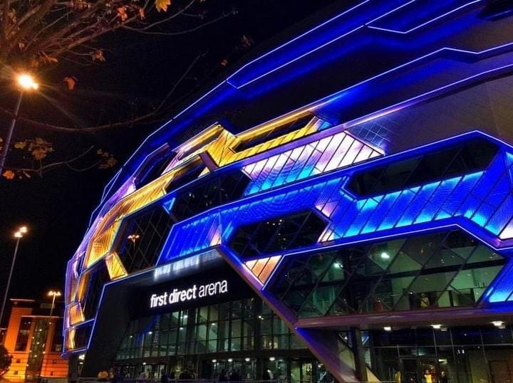
Super League Netball
LIVE SUPER-LEAGUE NETBALL
CAME BACK TO YORKSHIRE & LEEDS
LEEDS RHINOS NETBALL
Finish 6th in the
Vitality Netball Superleague 2022
Notes:
15

Slide 16
Accounts to 31st August 2021
Notes:
16

Slide 17
‘Membership 2021/22 (20/21)
Tales
Yorkshire West - Over 18 Members 1011 (754)
Yorkshire West - Under 18 Members 377 (361)
Yorkshire West - Under 14 Members 541 (531)
Yorkshire West - Under 11 Members 441 (296)
TOTAL: 2343 (1,943)
Totals
1,942
Notes:
17

Slide 18
County Membership Fee 2022/23
It is proposed that there will be no increase in the County Fees for 2022/23
This means the Fees will remain at
Over 18’s £6.00
Under 18’s £3.00
Under 14’s £3.00
Under 11’s £0.00
Notes:
18

Slide 19
Total Cost of Membership 2022/23
England Netball have advised that after a 7 year price freeze (5 years for Over 18’s) they will be making a small increase to the fees by an average of 3.7%, which is well below inflation
 | England Netball | Yorkshire Netball | West Yorkshire | TOTAL
Over 18 | £37.50 | £4.20 | £6.00 | £47.70
Under 18 | £17.00 | £4.20 | £3.00 | £24.20
Under 14 | £8.90 | £4.20 | £3.00 | £16.10
Under 11 | £5.50 | £1.00 | £0.00 | £ 6.50
Social & Supporting | £14.00 |  | £0.00
Secondary | £27.50 |  | £5.00
Primary | FREE |  | FREE
University | £180.00 |  | £60.00
Notes:
19

Slide 20
Amendments to the Constitution
The West Yorkshire County Netball Association Constitution went through a robust overhaul in 2020/21, that was agreed by the membership at the 2021 AGM
The County Committee are making no proposals to the Constitution in 2022
No proposals have been received from the Membership
Notes:
20

Slide 21
Election of Officers
County Management Board
ELECTED OFFICERS | Nominee | Proposed | Seconded
Chairperson | Pam Hoyle
Vice Chairperson | Vacant
Secretary | Yvonne Williams
Treasurer & Membership | Felicity O’Leary
Education and training – Officiating | Kirsty Woodhouse
Education and training - Coaching | Suphena Clarke
Performance & Talent | Lucy Oldroyd
Marketing & Communication | Vacant
Appointed Member | Jenny Skelton
1 elected member / 3 appointed | Vacant
REPRESENTATIVES | TBC
County League – Senior | Julie Thackray
County League – Junior | Amy Womersley
Huddersfield League | Anna Bartys
Schools and Education | Georgina Thompson
EN Netball Development Officer (WY) | Vacant
Notes:
21

Slide 22
Netball Development Officer
UPDATE
After 3 years in post, Corinne Hudson moved on from her post as West Yorkshire NDO in March, to take up a new position in London
Following the job vacancy advert by England Netball, I am please to inform you that following interview, Rachel Wood, has been appointed to this role.
Rachel will commence her post on the 6th July, initially for 3 days per week and then full-time from the 1st September
We are delighted to welcome Rachel to this role and wish her every success in supporting the development of netball across West Yorkshire
Notes:
22

Slide 23
A. O. B
Any Questions?
Well-being & Mental Health support
Notification
Date of AGM 2023
Tuesday, 20th June
7.00pm
All documents will be found on the County web-site
Notes:
23

Slide 24
What do we need from you?
Let us know what you want to see happen in your County!
Your feedback and views are important. Please contact us via the web-site with any thoughts and ideas on how we can improve our netball offer and support all our members.
However in order to achieve this we need your support:
More volunteers offering to come forward to help with planning and developing netball in the future.
Participation can be to suit your main interests or specific skills that can help with any of the committees, support small focus groups or individual projects and events
VOLUNTEERS MAKE THE GAME
&
TOGETHER WE ARE ONE TEAM!
Notes:
24

Slide 25
What could you do be to help?
An Invitation
to join us for a
‘County Planning Event’
on
Tuesday, 5th July 2022
6.30pm (arrival from 6.00pm) – 9.00pm
at
The Bobbin Carrier, Cleckheaton
Jct26 (M62/M606)
We would love to see you there!
Notes:
25

Slide 26
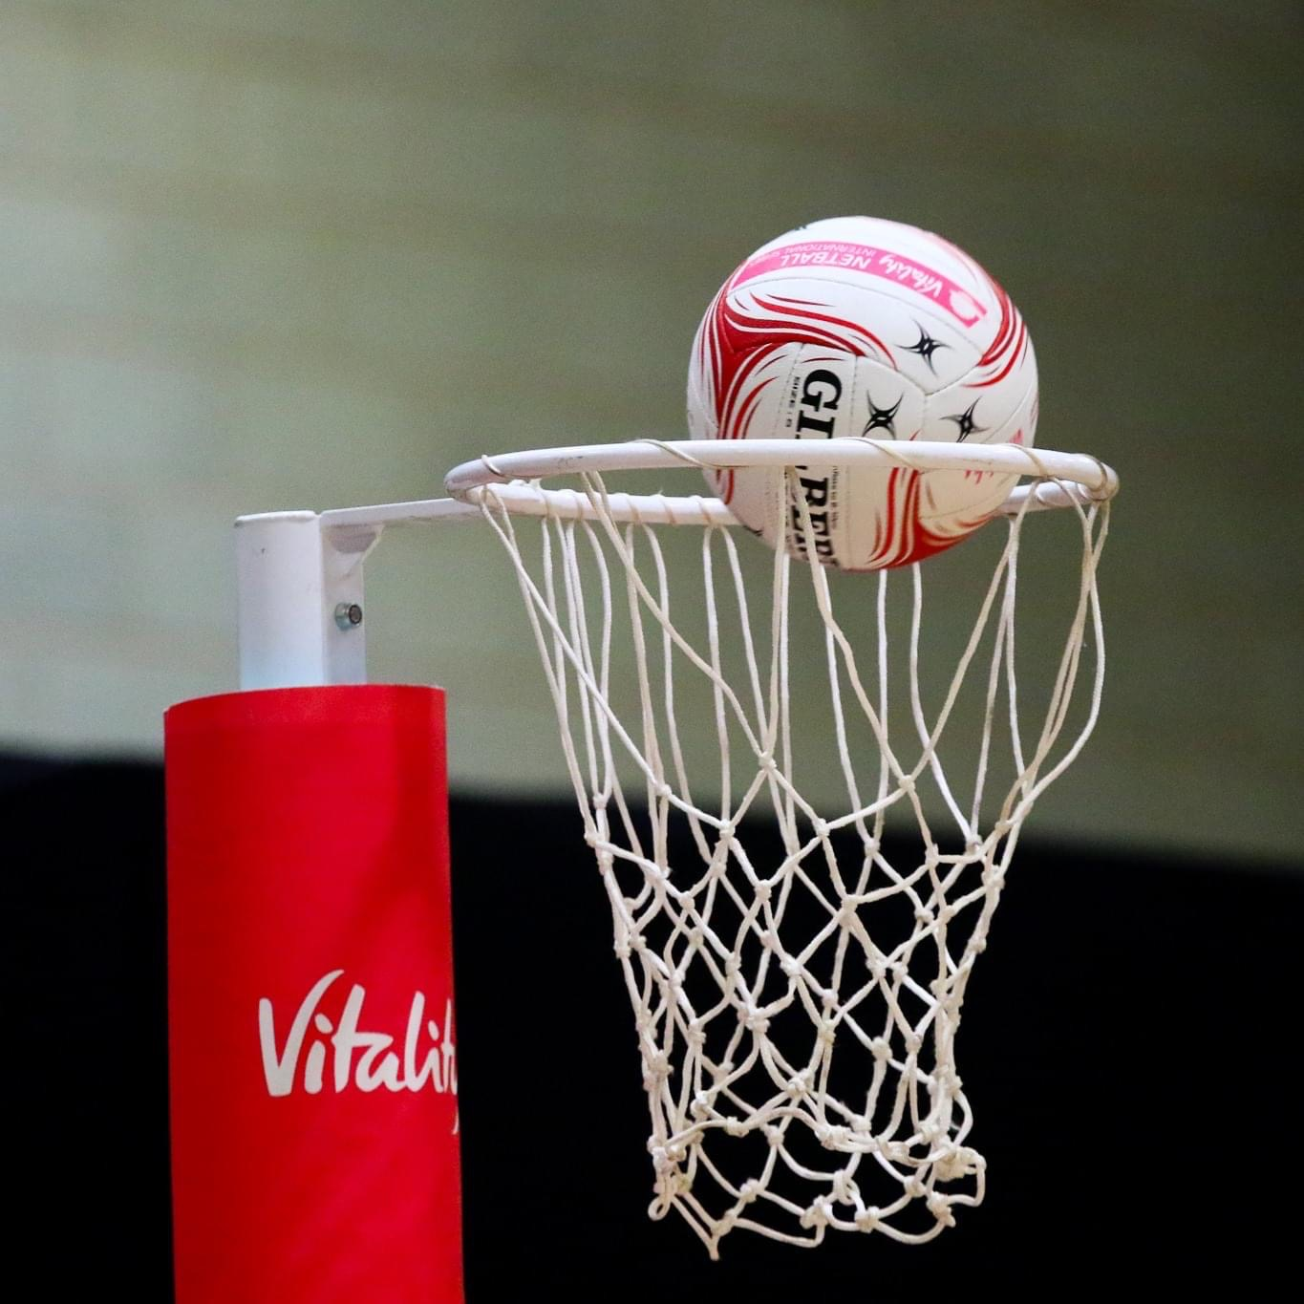
Together we are
ONE TEAM!

Slide 27
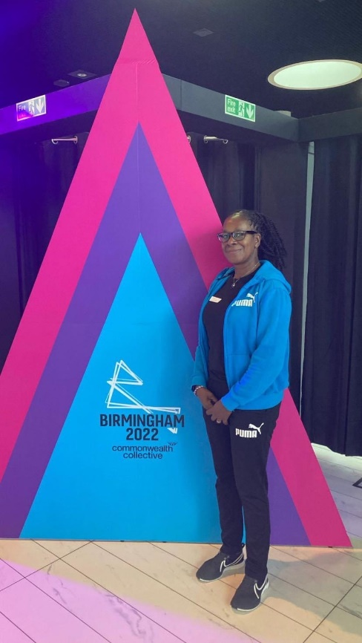
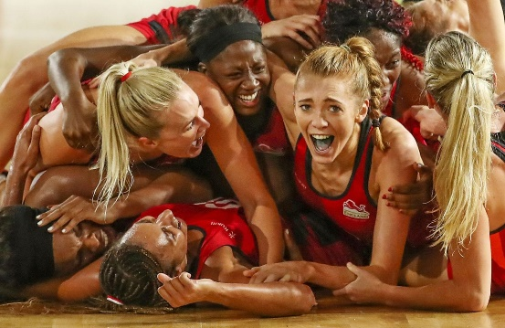
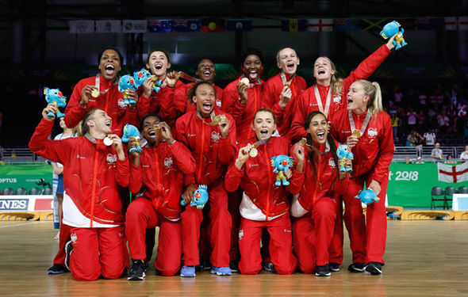
HAVE A GREAT SUMMER!
We wish the England Roses every success as they defend their Gold Medal at the Birmingham
2022 Commonwealth Games
If you have tickets, enjoy
If you are a volunteer, enjoy the
experience
Notes:
27

